Slide 1
Features of geometric sequences
Non-linear relationships

Slide 2
how to use Oak lessons

Slide 3
I can appreciate the features of a geometric sequence.

Slide 4
A geometric sequence is a sequence with a constant multiplicative relationship between successive terms.
A common ratio is a key feature of a geometric sequence. The constant multiplier between successive terms is called the common ratio.

Slide 5

Features of geometric sequences
Identifying geometric sequences
Generating geometric sequences

Slide 6
Identifying geometric sequences
Can you spot patterns and find the next three terms of these sequences.
7, | 12, | 17, | 22, | 27, | 32, | 37, | 42, …
+5
+5
+5
+5
+5
+5
+5
Common additive differences between terms makes these arithmetic (linear) sequences.
7, | 17, | 27, | 37, | 47, | 57, | 67, | 77, …
+10
+10
+10
+10
+10
+10
+10
28, | 19, | 10, | 1, | −8, | −17, | −26, | −35, | …
−9
−9
−9
−9
−9
−9
−9

Slide 7
Identifying geometric sequences
Can you spot patterns and find the next terms.
5, | 10, | 15, | 20, | 25, | 30, | …
Common additive difference - Arithmetic (linear) sequence.
+5
+5
+5
+5
+5
5, | 10, | 20, | 35, | 55, | 80, | …
No common additive difference.
Common 2nd difference - This is a special kind of non-linear sequence.
+5
+10
+15
+20
+25
+5
+5
+5
+5
5, | 10, | 20, | 40, | 80, | 160, | …
No common additive difference but, there is a pattern.
+5
+10
+20
+40
+80

Slide 8
Identifying geometric sequences
This last sequence is a special type of sequence.
5, | 10, | 20, | 40, | 80, | 160, | …
+5
+10
+20
+40
+80
This is clearly a very unique type of sequence.
+5
+10
+20
+40
+80
+5
+10
+20
+40
+80
5, | 10, | 20, | 40, | 80, | 160, | …
Can we look for a common 2nd difference?...
+5
+10
+20
+40
+80

Slide 9
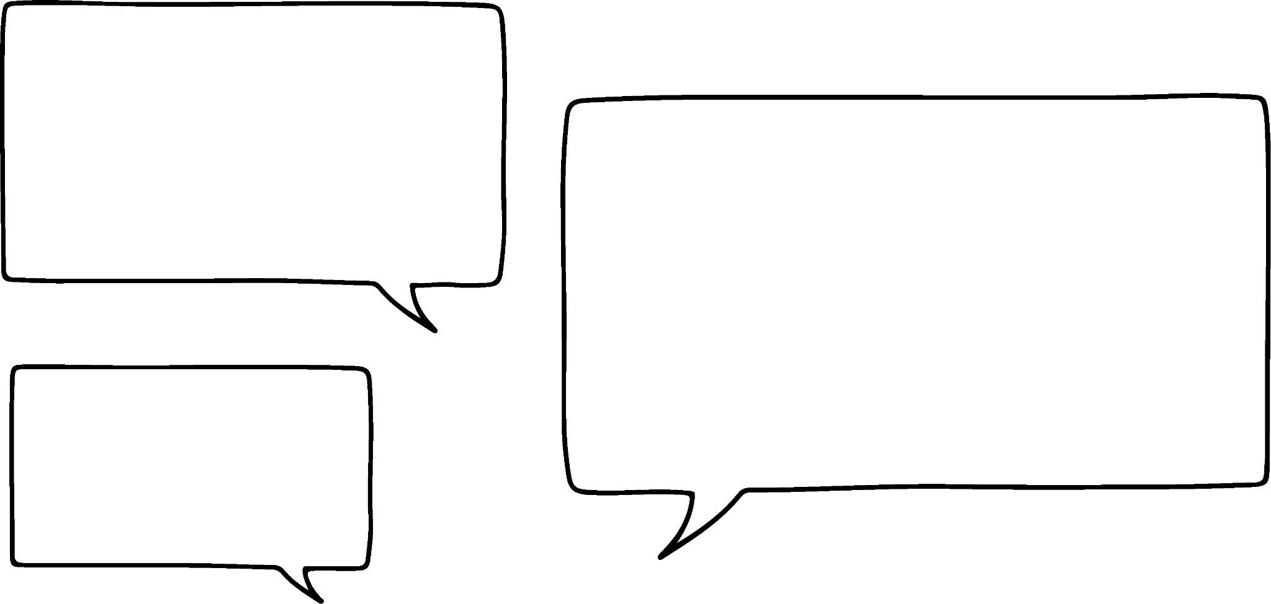

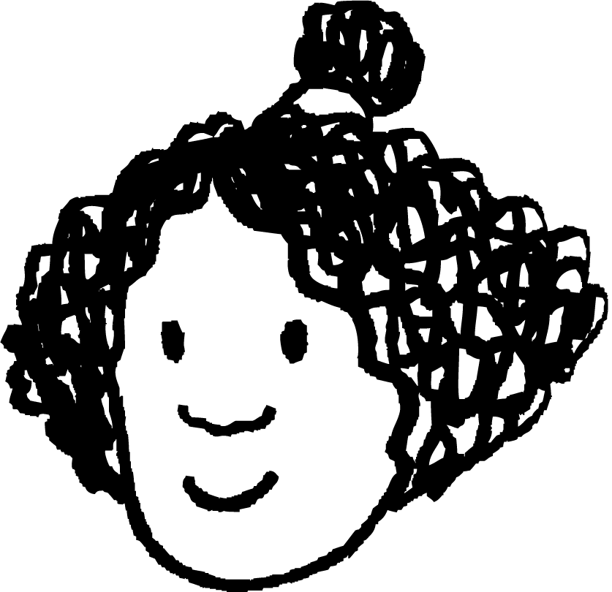
Identifying geometric sequences
This last sequence is a special type of sequence.
5 + 5
10 + 10
20 + 20
40 + 40
80 + 80
I think I see a more efficient way to describe this and it’s not additive.
I like this one. I see it as an “Add itself” sequence.
Andeep
Izzy
5, | 10, | 20, | 40, | 80, | 160, | …
Can you spot what Izzy has spotted?
+5
+10
+20
+40
+80

Slide 10
Identifying geometric sequences
This last sequence is a special type of sequence.
5 + 5 | = | 5 × 2
10 + 10
20 + 20
40 + 40
80 + 80
5 + 5
10 + 10
20 + 20
40 + 40
80 + 80
5 + 5 | = | 5 × 2
10 + 10 | = | 10 × 2
20 + 20 | = | 20 × 2
40 + 40 | = | 40 × 2
80 + 80 | = | 80 × 2
5 + 5
10 + 10
20 + 20
40 + 40
80 + 80
5 + 5 | = | 5 × 2
10 + 10 | = | 10 × 2
20 + 20
40 + 40
80 + 80
5 + 5 | = | 5 × 2
10 + 10 | = | 10 × 2
20 + 20 | = | 20 × 2
40 + 40
80 + 80
5 + 5 | = | 5 × 2
10 + 10 | = | 10 × 2
20 + 20 | = | 20 × 2
40 + 40 | = | 40 × 2
80 + 80
It’s actually a multiplicative sequence!
Andeep
Izzy
5, | 10, | 20, | 40, | 80, | 160, | …
+5
+10
+20
+40
+80

Slide 11
Identifying geometric sequences
This last sequence is a special type of sequence.
That’s far more efficient Izzy. Well spotted!
5 + 5 | = | 5 × 2
10 + 10 | = | 10 × 2
20 + 20 | = | 20 × 2
40 + 40 | = | 40 × 2
80 + 80 | = | 80 × 2
It’s actually a multiplicative sequence!
Andeep
Izzy
5, | 10, | 20, | 40, | 80, | 160, | …
×2
×2
×2
×2
×2

Slide 12
Identifying geometric sequences
Use Izzy’s term-to-term rule to find the next three terms.
5, | 10, | 20, | 40, | 80, | 160, | 320, | 640, | 1280, | …
×2
×2
×2
×2
×2
×2
×2
×2
Sequences with a common multiplicative relationship between successive terms are known as geometric sequences.

Slide 13

Identifying geometric sequences
Geometric sequences have a common additive difference between successive terms.
The common term-to-term rule in a geometric sequence is multiplicative.
The common term-to-term rule in a geometric sequence is additive.

Slide 14
Identifying geometric sequences
Find the next five terms of this geometric sequence.
2, | 6, | 18, | 54, | 162, | 486, | 1458, | 4374, | …
×3
×3
×3
×3
×3
×3
×3
Geometric sequences have a common multiplicative relationship between successive terms.

Slide 15
Identifying geometric sequences
What is the difference between the nature of these two sequences?
2, | 4, | 6, | 8, | 10, | …
Common additive difference between terms.
A linear (arithmetic) sequence.
+2
+2
+2
+2
2, | 4, | 8, | 16, | 32, | …
Common multiplicative relationship between successive terms. A geometric sequence.
×2
×2
×2
×2

Slide 16
Identifying geometric sequences
Andeep and Izzy are looking at this sequence.
1, | 2, | 6, | 24, | 120, | 720, | …
×2
×3
×4
×5
×6
This sequence is multiplicative between terms. Does that mean it’s geometric?
No. Be careful! It has to be the same multiplier between terms.
What do you think?
Geometric sequences have a common multiplicative relationship between successive terms.

Slide 17
Identifying geometric sequences
Geometric sequences have __________ multiplicative relationship between successive terms.
a common
an increasing
a common
an additive

Slide 18
Identifying geometric sequences
1) Sort these sequences into geometric, arithmetic and ‘other’.
a) 1, 2, 3, 4, 5, …
g) 4, 16, 30, 46, 64, …
b) 1, 2, 4, 8, 16, …
h) 10, 15, 20, 30, 40, …
c) 1, 2, 5, 10, 17, …
i) 10, 40, 70, 100, 130, …
d) −1, −2, −4, −8, −16, …
j) 10, 20, 60, 240, 1200, …
e) 1, 4, 16, 64, …
k) 10, 20, 40, 80, 160, …
f) 4, 16, 28, 40, 52, …
l) 10, 100, 1000, 10 000, …

Slide 19
Identifying geometric sequences
1) Sort these sequences into geometric, arithmetic and ‘other’.
Geometric sequences
×4
e) 1, 4, 16, 64, …
×2
b) 1, 2, 4, 8, 16, …
k) 10, 20, 40, 80, 160, …
×2
×2
d) −1, −2, −4, −8, −16, …
×10
l) 10, 100, 1000, 10 000, …
+12
Arithmetic sequences
f) 4, 16, 28, 40, 52, …
+1
+30
a) 1, 2, 3, 4, 5, …
i) 10, 40, 70, 100, 130, …
Other sequences
c) 1, 2, 5, 10, 17, …
h) 10, 15, 20, 30, 40, …
+1
+3
+5
+7
+5
+5
+10
+10
g) 4, 16, 30, 46, 64, …
j) 10, 20, 60, 240, 1200, …
+12
+14
+16
+18
×2
×3
×4
×5

Slide 20
Features of geometric sequences
Identifying geometric sequences
Generating geometric sequences

Slide 21


Generating geometric sequences
Lucas and Laura are generating geometric sequences.
I’m going to start with a first term of 1 and use a common ratio of 5 between the terms.
1, | 5, | 25, | 125, | 625, | …
×5
×5
×5
×5
I think I can generate the exact same sequence by starting on 1 and using a ratio of 1 : 5 between the terms.
Do you agree with Laura?

Slide 22
Generating geometric sequences
Lucas and Laura are generating geometric sequences.
×5
1, | 5, | 25, | 125, | 625, | …
1 | : | 5
5 | : | 25
25 | : | 125
125 | : | 625
×5
×5
×5
×5
I think I can generate the exact same sequence by starting on 1 and using a ratio of 1 : 5 between the terms.
We can use a ratio to describe the multiplicative relationships between successive terms in a geometric sequence.

Slide 23
Generating geometric sequences
Lucas and Laura are generating geometric sequences.
×5
1, | 5, | 25, | 125, | 625, | …
1 | : | 5
5 | : | 25
25 | : | 125
125 | : | 625
×5
×5
×5
×5
Using a common multiplier of 5, or a ratio of 1 : 5 between terms generates the same geometric sequence. The language we use for the common multiplier is to call it the common ratio.

Slide 24
Generating geometric sequences
Lucas and Laura are generating geometric sequences.
×2
Let’s check I’ve got this Laura! I can start on 7 and use a ratio of 1 : 2 to generate a sequence.
1 | : | 2
7 | : | 14
14 | : | 28
28 | : | 56
Well done Lucas! The sequence 7, 14, 28, 56, …
A geometric sequence with a common ratio of 2

Slide 25

Generating geometric sequences
Lucas and Laura are generating geometric sequences.
You couldn’t have a common ratio of though could you Laura? It has to be greater than one right?
Can you answer Lucas’ question?
Well done Lucas! The sequence 7, 14, 28, 56, …
A geometric sequence with a common ratio of 2

Slide 26
Generating geometric sequences
Lucas and Laura are generating geometric sequences.
You couldn’t have a common ratio of though could you Laura? It has to be greater than one right?
2 | : | 1
128 | : | 64
64 | : | 32
32 | : | 16
16 | : | 8
It is possible! For example, start with a 1st term of 128 and use a ratio of 2 : 1 between terms.

Slide 27
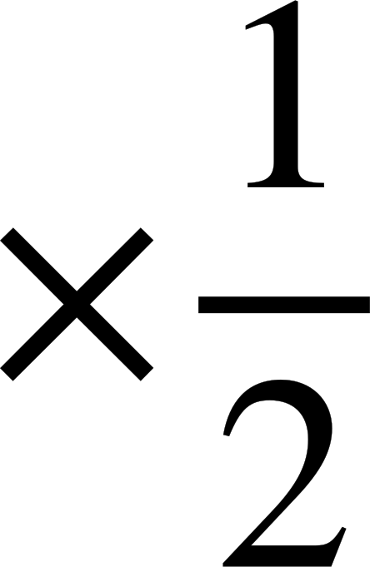
Generating geometric sequences
Lucas and Laura are generating geometric sequences.
Nice! The sequence 128, 64, 32, 16, 8, … So using the ratio of 2 : 1, a common ratio of between terms, makes the sequence decrease!
2 | : | 1
128 | : | 64
64 | : | 32
32 | : | 16
16 | : | 8
128, 64, 32, 16, 8, …
It is possible to have decreasing geometric sequences.

Slide 28
Generating geometric sequences
Generate the first five terms of the geometric sequence with 1st term 81 and a ratio of 3 : 4 between successive terms.
3 | : | 4
81 | : | 108
108 | : | 144
144 | : | 192
192 | : | 256
81, 108, 144, 192, 256, …

Slide 29
Generating geometric sequences
Generate the first five terms of the geometric sequence with 1st term 81 and a ratio of 3 : 4 between successive terms.
Generate the first five terms of the geometric sequence with 1st term 16 and a ratio of 2 : 5 between successive terms.
3 | : | 4
81 | : | 108
108 | : | 144
144 | : | 192
192 | : | 256
2 | : | 5
16 | : | 40
40 | : | 100
100 | : | 250
250 | : | 625
81, 108, 144, 192, 256, …
16, 40, 100, 250, 625, …

Slide 30
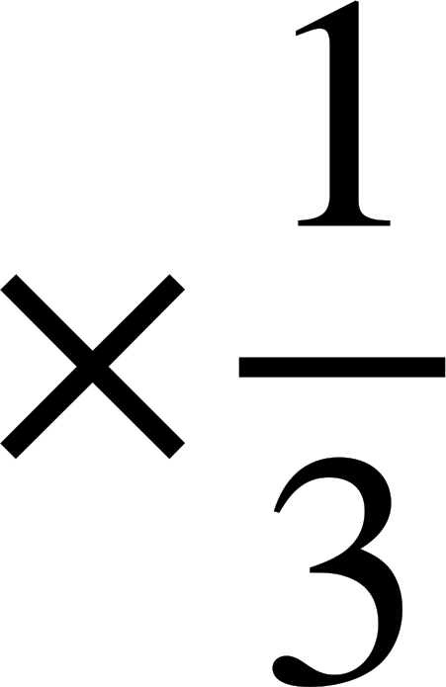


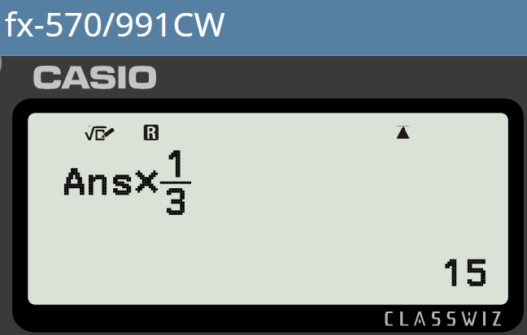
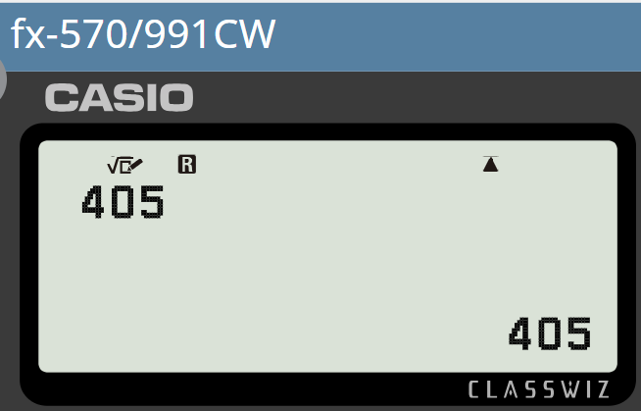
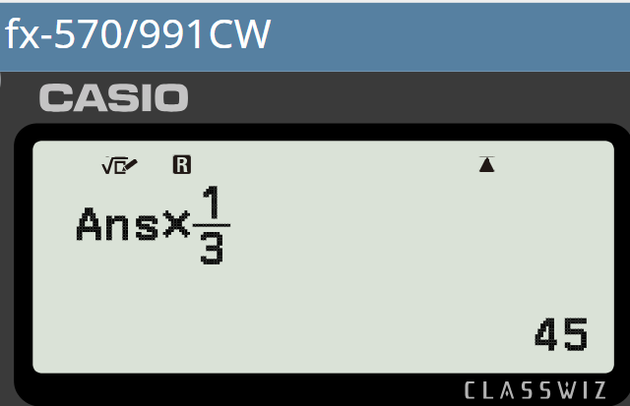
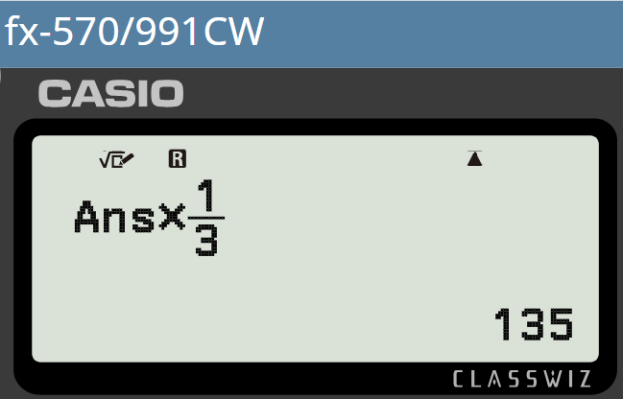
Generating geometric sequences
Generate the first seven terms of the geometric sequence with 1st term 405 and common ratio of
405, 135,
405,
405, 135, 45, 15, 5, , , …
405, 135, 45,

Slide 31
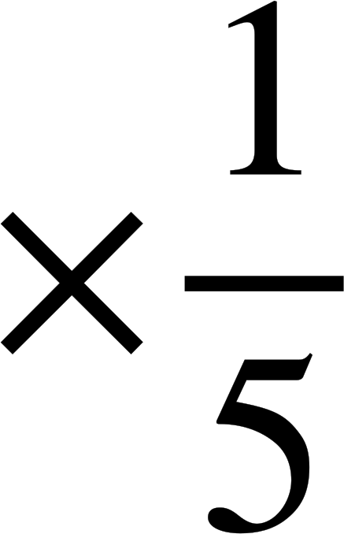

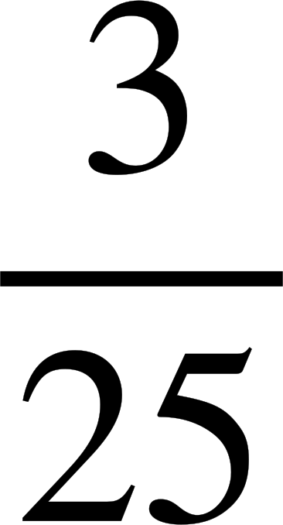
Generating geometric sequences
Generate the first seven terms of the geometric sequence with 1st term 405 and common ratio of
Generate the first six terms of the geometric sequence with 1st term 375 and common ratio of
405, 135,
405,
405, 135, 45, 15, 5, , , …
405, 135, 45,
375, 75, 15, 3, , , …
Non-integer terms are often more efficiently and accurately communicated as fractions.

Slide 32



Generating geometric sequences
Lucas and Laura are generating geometric sequences.
128, 64, 32, 16, 8, 4, 2, 1, , , , , …
I’ve continued this geometric sequence and realised something really cool!
Despite decreasing it will never reach zero.
Does that mean we will never see negative terms in geometric sequences?
What do you think?

Slide 33
Generating geometric sequences
Lucas and Laura are generating geometric sequences.
No. I saw a sequence with a common ratio ×2 and a first term of −1
It had all negative terms.
−1, −2, −4, −8, −16, …
Nice! Let’s experiment. What if we switch them around? Make the first term 2 and the multiplier −1
2, | −2, | 2, | −2, | 2, | −2, | …
×−1
×−1
×−1
×−1
×−1
What do you think will happen?

Slide 34
Generating geometric sequences
Lucas and Laura are generating geometric sequences.
It’s oscillating between positive and negative! That’s beautiful!
Nice! Let’s experiment. What if we switch them around? Make the first term 2 and the multiplier −1
2, | −2, | 2, | −2, | 2, | −2, | …
×−1
×−1
×−1
×−1
×−1
What do you think will happen?

Slide 35
Generating geometric sequences
Find the next four terms of this geometric sequence.
3, | −9, | 27, | −81, | 243, | −729, | …
×−3
×−3
×−3
×−3
×−3
When the common ratio is negative we get oscillating geometric sequences.

Slide 36
Generating geometric sequences
1) Generate the first five terms of these geometric sequences.
a) 1st term 1, common ratio of 3
b) 1st term 10, common ratio of 3
c) 1st term 5, ratio 1 : 3 between terms
d) 1st term 3, a ratio 1 : 5 between terms
e) 1st term 64, a ratio 2 : 5 between terms
f) 1st term 81, common ratio of
g) 1st term 1875, a ratio 5 : 1 between terms
h) 1st term 3, a ratio 3 : 1 between terms

Slide 37




Generating geometric sequences
2) Alex is generating these geometric sequences.
a) 1st term 216, common ratio
b) 1st term 216, common ratio
c) 1st term 216, common ratio
Because these multipliers are fractions, all of these will be decreasing sequences.
Show Alex that he is wrong.

Slide 38
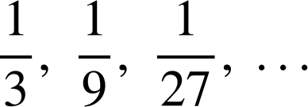
Generating geometric sequences
1) Generate the first five terms of these geometric sequences.
a) 1st term 1, common ratio of 3
1, 3, 9, 27, 81, …
b) 1st term 10, common ratio of 3
10, 30, 90, 270, 810, …
c) 1st term 5, ratio 1 : 3 between terms
5, 15, 45, 135, 405, …
d) 1st term 3, a ratio 1 : 5 between terms
3, 15, 75, 375, 1875, …
e) 1st term 64, a ratio 2 : 5 between terms
64, 160, 400, 1000, 2500, …
f) 1st term 81, common ratio of
81, 27, 9, 3, 1, …
g) 1st term 1875, a ratio 5 : 1 between terms
1875, 375, 75, 15, 3, …
3, 1,
h) 1st term 3, a ratio 3 : 1 between terms

Slide 39
Generating geometric sequences
2) Alex is generating these geometric sequences.
a) 1st term 216, common ratio
216, 72, 24, 8, …
b) 1st term 216, common ratio
216, 144, 96, 64, …
c) 1st term 216, common ratio
216, 324, 486, 729, …
Multiplier is greater than 1, therefore the sequence increases.
Because these multipliers are fractions, all of these will be decreasing sequences.
Show Alex that he is wrong.

Slide 40
Features of geometric sequences
Geometric sequences have the key feature of a common multiplicative relationship from term-to-term.
This multiplicative relationship is also called a common ratio.
Example,
3, | 30, | 300, | 3000, | 30 000, | …
×10
×10
×10
×10
The common multiplier ×10 we call a common ratio of 10.

Slide 41

© Oak National Academy 2024.
Produced in partnership with Mathematics in Education and Industry.
Licensed on the Open Government Licence v3.0, except where otherwise stated. See Oak terms and conditions.

